Slide 1

Unmasking the digital shadows: The Art and Science of Digital Forensics Investigation
Digital Forensics

Slide 2
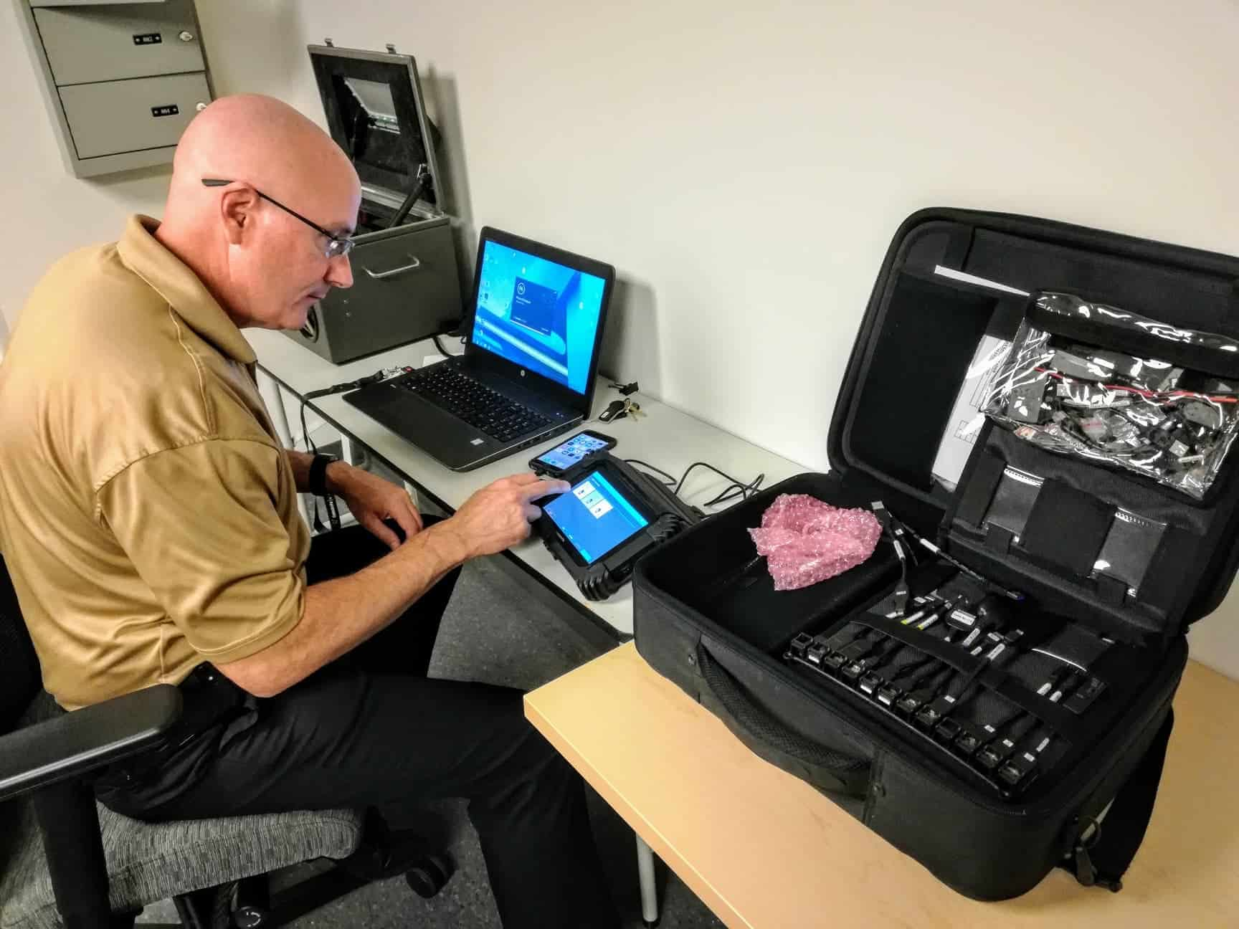
In today’s digital age, forensics investigation plays a crucial role in uncovering the truth. Digital forensics is the scientific and systematic process of collecting, analyzing and preserving electronic data to investigate cyber crimes, tax evasion, security breaches, with presenting findings to the legal proceedings.
Introduction to Digital 4n6

Slide 3
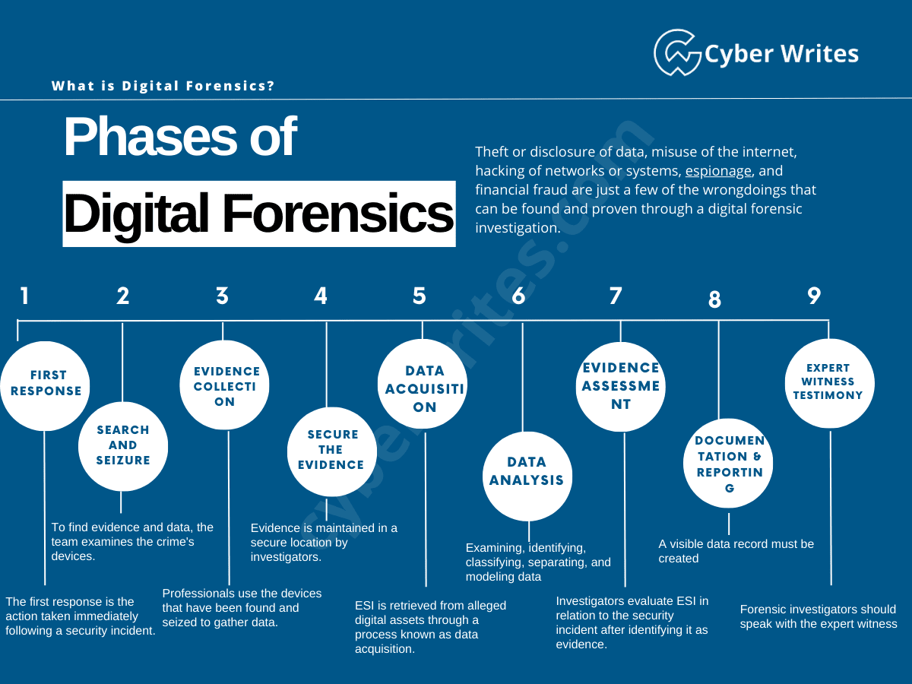


Slide 4
Digital Forensics Life Cycle
Identification
(First, find the evidence, noting where it is stored)
Preservation
Next, isolate, secure, and preserve the data. This includes preventing people from possibly tampering with the evidence.
Analysis
Next, reconstruct fragments of data and draw conclusions based on the evidence found.
Documentation and Reporting
Following that, create a record of all the data to recreate the crime scene
Presentation
Lastly, summarize and draw a conclusion

Slide 5
The key principles include identification, preservation, analysis, documentation and presentation of digital evidence. Each step must be meticulously documented to maintain the integrity of the evidence. This ensures that the findings are both reliable and admissible in the court of law or legal proceedings
Key Principles of Digital 4n6

Slide 6
Type of Digital Forensics (NIST SP 800-86)
Crypto Currency Forensics
GPS Forensics
Memory Forensics
Social Media Forensics
Mobile Forensics
Printer Forensics
Network Forensics
IoT Forensics
Malware Forensics
Computer Forensics
Cloud Forensics
Email Forensics
Database Forensics
CCTV Forensics

Slide 7
Standards, Guidelines and Best Practices:
Handling digital evidence at the crime scene or while doing a digital forensics and digital evidence examinations.
IOCE (International Organization on Computer Evidence)
SWGDE (Scientific Working Group on Digital Evidence)
DFRWS (Digital Forensic Research Workshop)
ACPO (Association of Chief Police Officers)

Slide 8
Digital Forensics Investigation Models/Frameworks
ACPO- Focusing on best practices for handling digital evidence to ensure its integrity, and proper documentation, maintaining the chain of custody and using validated tools.
NIST Digital Forensics Framework – Collecting, Preservation, Analysis, Presentation of Digital evidence.
SANS Digital forensics framework- focusing on incident response and digital forensics.

Slide 9
Destroying digital evidence or media after a digital forensics' investigation must be done carefully and legally, especially if the evidence may have legal implications. Data Wiping DoD 5220.22-M (DBAN, Eraser) Physical Destruction (Dismantling, Shredding, Drilling) Degaussing (Magnetic field Eraser) Verification Chain of Custody Note: Legal Implications: Understand the legal context of the evidence being destroyed. In some cases, data must be retained for a specified period. Data Sensitivity: Consider the sensitivity of the data. Highly sensitive information may require more rigorous destruction methods.

Slide 10
Best Practices for Digital Forensics
Adopting best practices such as
maintaining a chain of custody, using
validated tools, and documenting every
step is essential. These practices help
ensure the reliability and credibility of
the forensic process, ultimately
supporting successful investigations.

Slide 11
Challenges in Digital Forensics
Digital forensics faces several
challenges, including encryption,
data volume, server geo-location and evolving
technology. Staying updated with
the latest trends and tools is vital
for forensic professionals to
effectively tackle these challenges
during investigations

Slide 12
Thank You.
Rajadhurai Saravanan
+91 9363032022
Rajadhurai_sentinel@proton.me

Slide 13
DF Practical and Challenges:
Forensic imaging 1. Live imaging
(FTK, EnCase, X-ways Forensics, Oxygen Forensics, MSAB, Cellebrite, Magnet Axiom, Autopsy, )
2. Dead Imaging (Chip-off Forensics)
Data Carving: Test Disk, Autopsy, EnCase, FTK, Bulk_Extractor, X-Ways Forensics, etc.,

